Slide 1

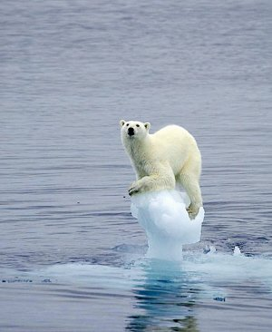
Unit 3 Preserving our planet
Despite decades of scientific research, no one yet knows how much damage human activity is doing to the environment. Humans are thought to be responsible for a large number of environmental problems, ranging from global warming to ozone depletion. What is not in doubt, however, is the devastating effect humans are having on the animal and plant life of the planet.
do damage to 使…受到损害
have an effect/act /impact on 对…产生效果/影响

Slide 2
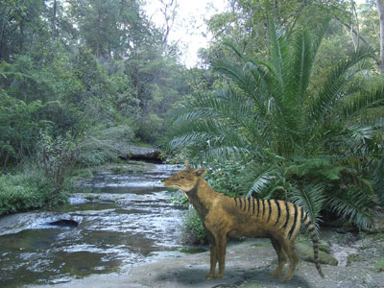
Currently, an estimated 50,000 species become extinct every year. “If this carries on, the impact on all living creatures is likely to be profound,” says Dr Nick Middleton, a geographer at Oxford University. “All species depend in some way on each other to survive. And the danger is that, if you remove one species from this very complex web of interrelationships, you have very little idea about the knock-on effects on the ecosystem. So, if you lose a key species, you might cause a whole flood of other extinctions.”
have little/no idea 很难/根本不知道
knock-on effects 连锁作用
a flood of 大批,大量

Slide 3
Complicating matters is the fact that there are no obvious solutions to the problem. Unlike global warming and ozone depletion—which, if the political will was there, could be reduced by cutting gas emissions—preserving bio-diversity remains an intractable problem.
The latest idea is “sustainable management”. This means humans should be able to use any species of animal or plant for their benefit, provided enough individuals of that species are left alive to ensure its continued existence.

Slide 4
Sustainable management is seen as a practical and economical way of protecting species from extinction. Instead of depending on largely ineffective laws against illegal hunting, it gives local people a good economic reason to preserve plants and animals. In Zimbabwe, for instance, there is a sustainable management project to protect elephants. Foreign tourists pay large sums of money to kill these animals for sport. This money is then given to the inhabitants of the area where the hunting takes place. In theory, locals will be encouraged to protect elephants, instead of hunting them illegally—or allowing others to do so—because of the economic benefit involved.

Slide 5
This sounds like a sensible strategy, but it remains to be seen whether it will work. With corruption popular in many developing countries, some observers are suspicious that the money will actually reach the people it is intended for. Others wonder how effective the locals will be at stopping illegal hunters.
There are also questions about whether sustainable management is practical when it comes to protecting areas of great bio-diversity such as the world’s tropical forests. In theory, the principle should be the same as with elephants—allow logging companies to cut down a certain number of trees, but not so many as to completely destroy the forest.

Slide 6
Sustainable management of forests requires controls on the number of trees which are cut down, as well as investment in replacing them. Because almost all tropical forests are located in countries which desperately need income from logging, there are few regulations and incentives to do this. In fact, for loggers, the most sensible economic approach is to cut down as many trees as quickly as possible.
One reason is the stable price of most commercial tree species in tropical forests. Typically, they rise in value annually by, at most, four to five per cent. Contrast this with interest rates in most developing countries, where investors can typically expect returns of 15 per cent or more. Clearly, it makes no economic sense to delay harvests.

Slide 7
One solution might be to verify wood which comes from sustainably managed forests. In theory, consumers would buy only this wood and so force logging companies to go "green" or go out of business. Unfortunately, unrestricted logging is so much more profitable that wood prices from managed forests would cost up to five times more - an increase that consumers, no matter how “green”, are unlikely to pay.
For these reasons, sustainable management of tropical forests is unlikely to become widespread in the near future. This is disheartening news. It’s estimated that these forests contain anything from 50 to 90 per cent of all animals and plant species on Earth. In one study of a five-square-kilometer area of rain forest in Peru, for instance, scientists counted 1,300 species of butterfly and 600 species of bird. In the entire continental United States, only 400 species of butterfly and 700 species of bird have been recorded.

Slide 8
Scientist Professor Norman Myers sees the situation as a tremendous “experiment we’re conducting with our planet”. “We don’t know what the outcome will be. If we make a mess of it, we can’t move to another planet… It’s a case of one planet, one experiment.”

Slide 9
V & S
C. 1. investment
2. species
3. tropical
4. suspicious
5. environment
6. in doubt
7. up to
8. tremendous
9. out of business
10. involving

Slide 10
11. desperately
12. sensible
13. preserve
14. in theory

